Slide 1
Introduction to Windows forms

Slide 2
Windows forms
Windows forms (WinForms) is a graphical user interface (GUI)
WinForms is included as a part of Microsoft .NET Framework.
Created for client-side desktop applications.
WinForms is a first generation GUI technology, therefore WinForms UI layout is very simplistic and limited.
One of the problems with WinForms is that it cannot resize controls without awkward event handler code being written.
WinForms is very easy to get started with and is good for rapid prototyping.

Slide 3
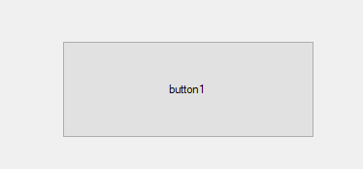
Controls in WinForms
Controls in WinForms are all objects.
They can be “manipulated” in the code behind.
When you add controls to the “Form” they get generated into the “Design” class.
The design class is autogenerated and should not be updated by the programmer.
The design class is a partial class of the code behind class of the Form.

Slide 4
Exercise Celsius to Fahrenheit
Create a WinForms Project
Create two textboxes and a button.
The first textbox should take in a number in Celsius
The second text should be used to display the value in Fahrenheit
The result should be displayed when the button is clicked.
The user should not be able to write into the second textbox.
To calculate Celsius to Fahrenheit, use the following math formula
Celcius x 1,8 + 32
When finished, try to make the layout look nice. ☺

Slide 5
Exercise extend the Celsius to Fahrenheit task
Take the WinForms application from before and add two radio buttons.
One should say: From Fahrenheit to Celsius.
The other should say: From Celsius to Fahrenheit.
Make it so you can toggle between the two radio buttons and that way pick which conversation you want to make.
The formula for Fahrenheit to Celsius is
(Fahrenheit – 32) / 1,8

Slide 6
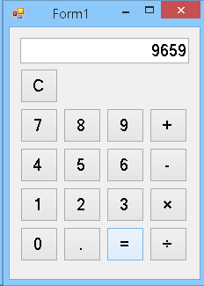
Exercise Calculator
Create a new WinForms application.
Create a UI layout that represents a calculator.
Make it so it can create simple arithmetic operations: +, -, x, %.
Make it so the result is displayed in a textbox
It should be possible to clear the result window.

Slide 7
Alternative to calculator
1) You can either decide to play around with the UI controls in WinForms.
2) Try to take one of you old programs and make it into a WinForms application. An example could be the Binary to Decimal converter we created a few weeks ago.

